Slide 1
REDUCING TRAFFIC MORTALITY USING DATA ANALYSIS AND MACHINE LEARNING
PRESENTED BY GUIDED BY
ROSHNI K (2022PECCS270) DR. M. SHYAMALA DEVI
SHAMILI R (2022PECCS289) CSE DEPARTMENT

Slide 2
ABSTRACT
This project aims to develop a machine learning-based application that predicts accident zones based on statistical data of accidents and alerts users when they use routes with high accident risk on Google Maps. By leveraging a large dataset of accident statistics, including factors such as weather, time of day, road conditions, and accident severity, our model will identify high-risk areas and provide personalized alerts to users. Using a gradient boosting algorithm and integrating with the Google Maps API, our system will predict accident risk for each segment of a route and provide a comprehensive risk assessment for the entire journey. This project has the potential to reduce accidents and improve road safety by providing users with critical information to make informed decisions about their routes.

Slide 3
OBJECTIVE
The objective of this project is to develop a machine learning-based web application that predicts accident-prone zones using historical road accident data and provides real-time alerts to users navigating through these areas. By integrating with Google Maps, the system will analyze statistical data to identify high-risk routes, enhancing road safety and helping users make informed decisions while driving. The system will notify users via real-time alerts when they are approaching dangerous zones, aiming to reduce accidents and improve overall road safety through predictive technology.

Slide 4
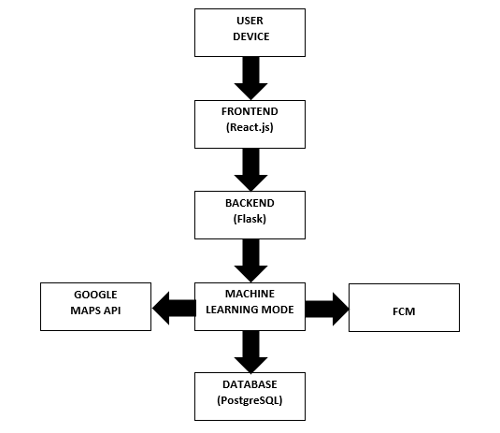
ARCHITECTURE

Slide 5
At the core of this architecture is a seamless integration of various components, including user devices, a responsive frontend, a robust backend, and a sophisticated machine learning model. The architecture is designed to facilitate efficient communication between these elements, enabling real-time data processing and predictive analytics.
Users access the application through their devices, where a user-friendly interface built with React.js allows for easy route input and visualization of potential hazards. The backend, powered by Flask, manages requests and orchestrates interactions among the system components, while a PostgreSQL database stores historical accident data essential for predictive modeling.
The machine learning model utilizes historical data to identify patterns and predict accident-prone zones, providing users with valuable insights during their journeys. By integrating the Google Maps API, the application visualizes routes and overlays accident data, enhancing situational awareness for users.
Furthermore, the system employs Firebase Cloud Messaging (FCM) to deliver real-time notifications, alerting users when they approach areas with a high risk of accidents. This proactive approach aims to empower users with the information they need to make safer travel decisions.
Overall, this architecture is designed not only to improve user experience but also to contribute significantly to road safety by reducing the likelihood of accidents through timely information and insights.

Slide 6
EXISTING SYSTEM
The existing system for route planning and navigation relies on traditional GPS navigation systems such as Google Maps and Waze, which provide turn-by-turn directions and traffic updates. However, these systems do not provide personalized accident risk assessments or alerts to users. Accident prediction systems such as iRAP and Road Safety Analytics exist, but they do not integrate with route planning and navigation systems to provide real-time alerts to users.
LIMITATIONS:
Reactive nature
Lack of Machine Learning Integration
No real-time alerts for predicted hazards
Limited Predictive Analytics

Slide 7
PROPOSED SYSTEM
The proposed system is a machine learning-based application that predicts accident zones based on statistical data of accidents and alerts users when they use routes with high accident risk on Google Maps. The system will leverage a large dataset of accident statistics, including factors such as weather, time of day, road conditions, and traffic volume, to identify high-risk areas and provide personalized alerts to users.

Slide 8
ADVANTAGES OF PROPOSED SYSTEM
Provides personalized accident risk assessments and alerts to users
Integrates with route planning and navigation systems to provide real-time alerts
Leverages machine learning and data analytics to improve accident prediction accuracy
Has the potential to reduce accidents and improve road safety by providing users with critical information to make informed decisions about their routes.

Slide 9
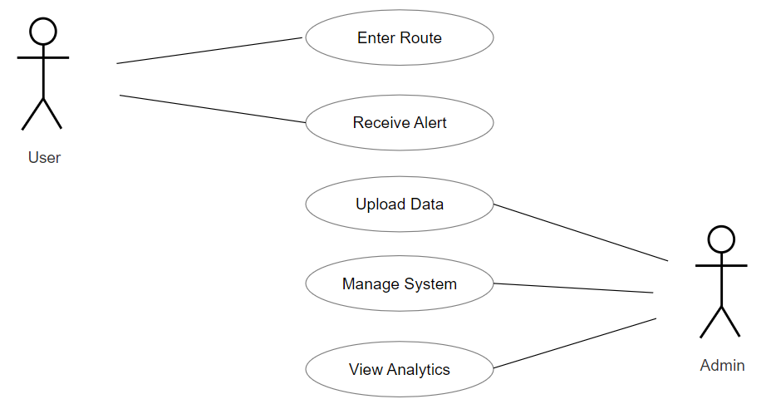
USE CASE DIAGRAM

Slide 10
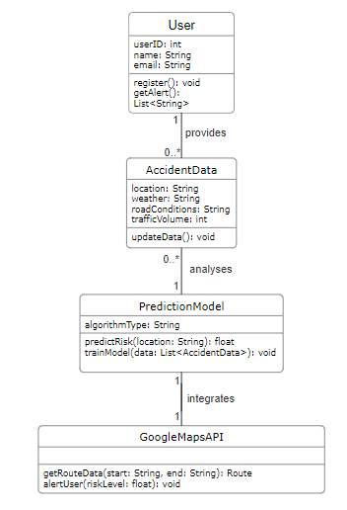
CLASS DIAGRAM

Slide 11
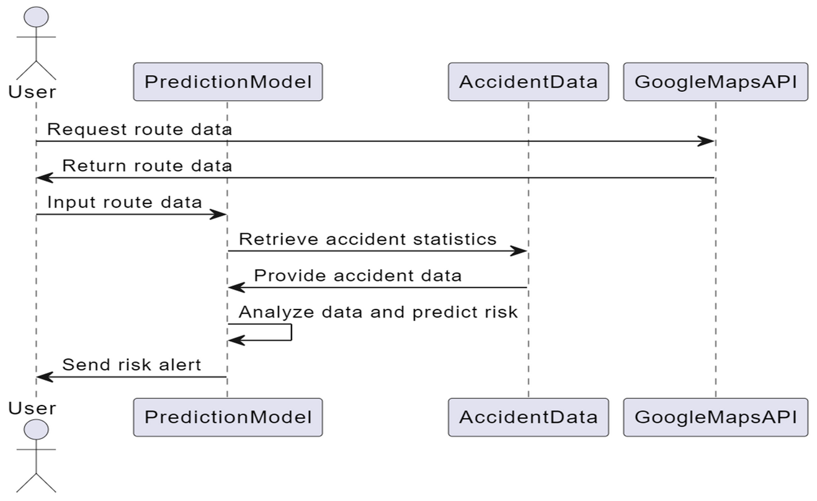
SEQUENCE DIAGRAM

Slide 12
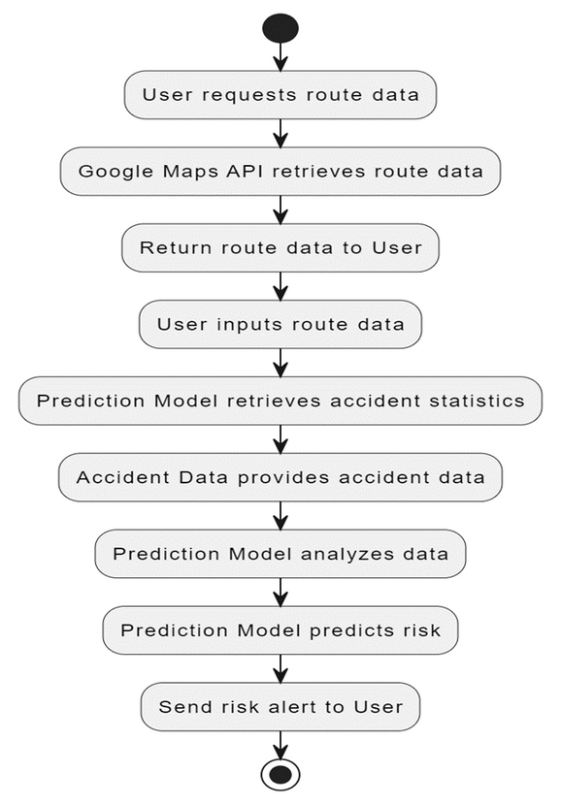
ACTIVITY DIAGRAM

Slide 13
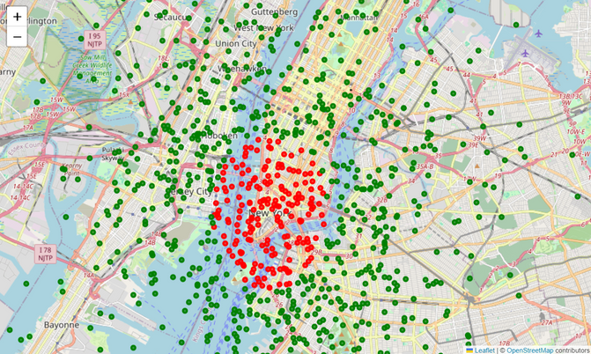
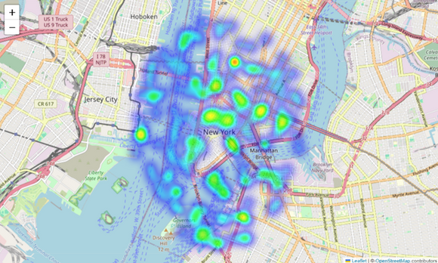
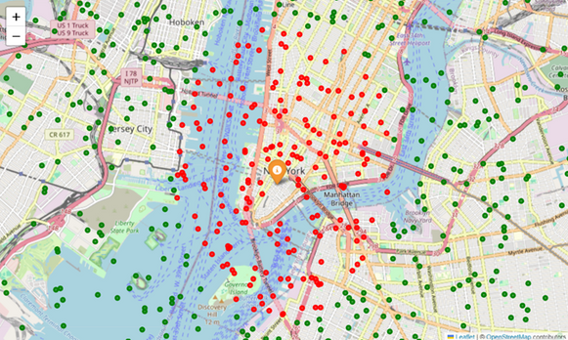
SCREENSHOTS
USING THE FOLIUM LIBRARY TO VISUALIZE ACCIDENT-PRONE AND SAFE LOCATIONS.
CREATING A HEATMAP TO VISUALIZE ACCIDENT-PRONE AREAS ON A FOLIUM MAP
MARKING THE LOCATION AS EITHER ACCIDENT-PRONE OR SAFE BASED ON machine learning model's prediction.

Slide 14
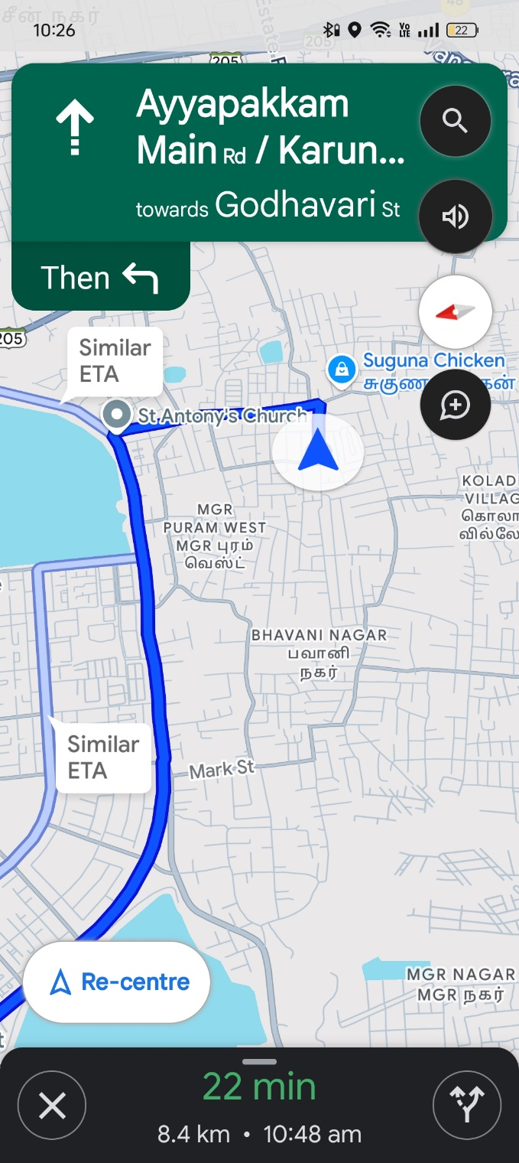
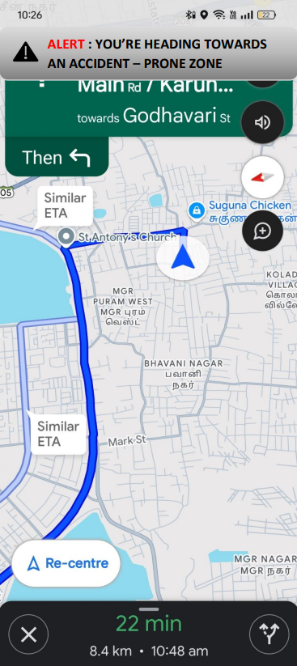
SIMULATED OUTPUT
Using Google Maps to reach a destination
Application pushing notification when heading towards accident –prone zone

Slide 15
FUTURE ENHANCEMENTS
Enhancing the Model: Exploring more advanced models, such as Gradient Boosting Machines or Neural Networks, may improve predictive accuracy.
Incorporating More Data Sources: Leveraging real-time traffic and weather data could enhance the model's ability to predict accidents under varying conditions.
User Interface Enhancements: Developing a more intuitive user interface with features such as accident history visualization and predictive trend analysis would enrich the user experience.
Broader Deployment: Testing the application in various geographical areas to assess its adaptability and performance across different urban environments.

Slide 16
CONCLUSION
This project presents a machine learning-based web application for predicting accident-prone zones, highlighting the importance of proactive safety measures in urban transportation. By employing a Random Forest model and integrating real-time notifications through Google Maps, the system demonstrates a significant potential for improving road safety. User feedback validates the system's effectiveness and usability, suggesting its applicability in real-world scenarios. Future work will aim to enhance model accuracy and expand the application’s features, further contributing to the ongoing effort to reduce road accidents

Slide 17
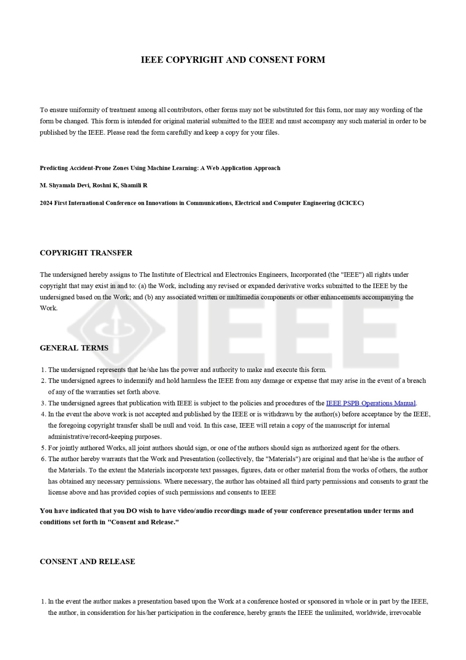
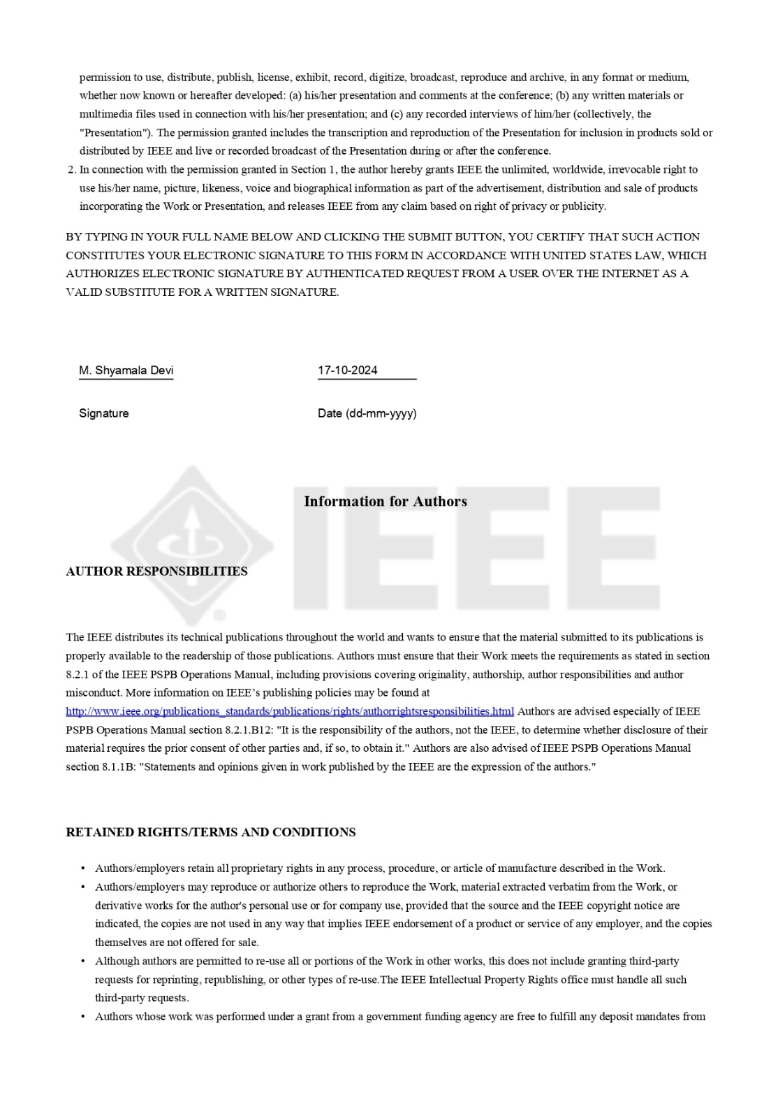
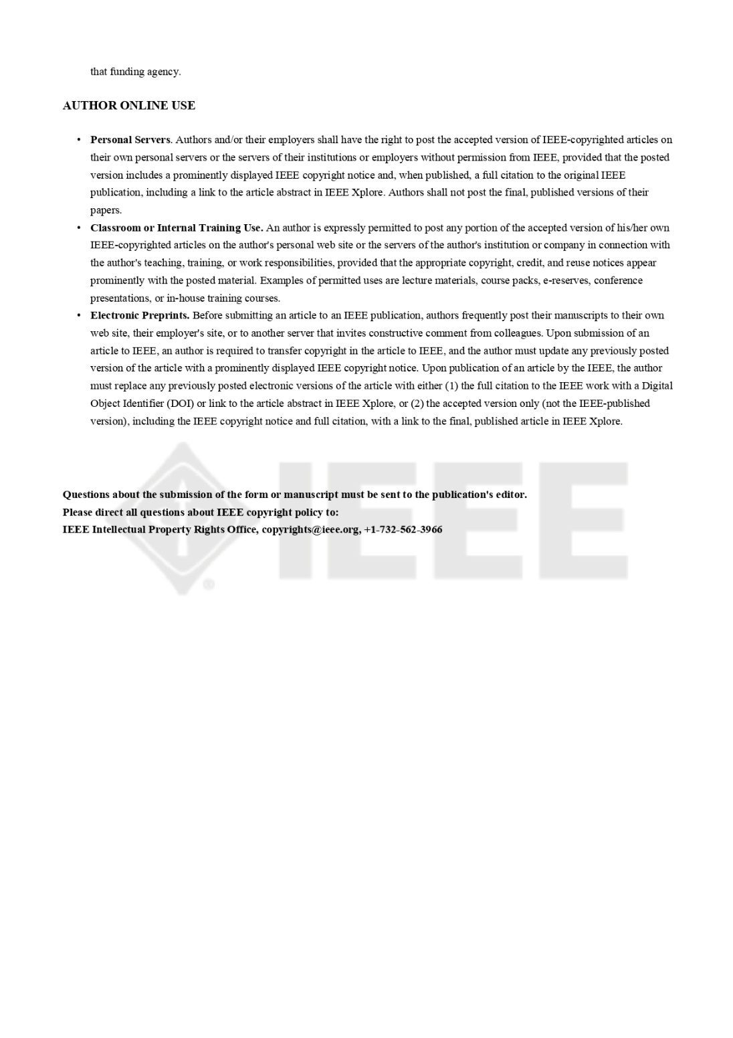
CONFERENCE

Slide 18
THANK YOU

